Slide 1
Leishmania Drug Resistance Genomics
Kathryn Crouch
Mani Mudaliar
Jon Wilkes

Slide 2
Genomics Workflow
Session 1
Session 2
Session 3
Session 4
Obtain Read Data
Quality Control Reads
Align Reads to Genome
Quality Control Alignment
Call Variants
Filter Variants
Annotate Variants
Identify Changes

Slide 3
Session 3
Filtering variants
Exploration of variants (vcf files)
Variant annotation and effect prediction

Slide 4
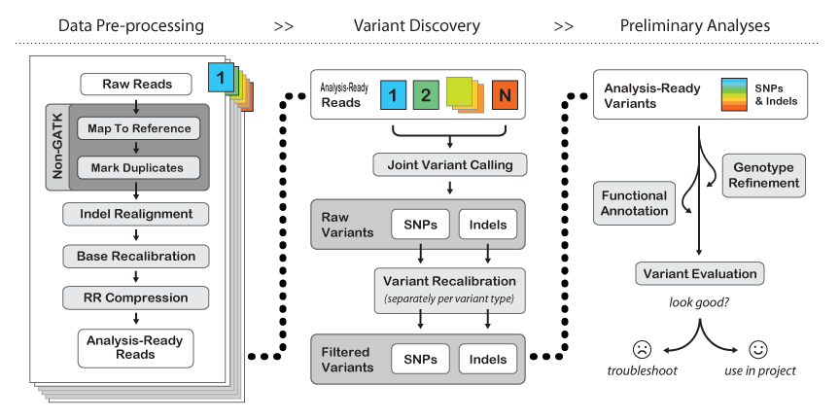
GATK Variant Calling Best Practices Workflow

Slide 5
Software
IGV – for browsing the alignments (install on your local computer)
http://www.broadinstitute.org/software/igv/log-in
Move or copy your reference and bam/vcf files to ~/www/Data and use “Load from URL” in IGV

Slide 6
Software
SnpEff
http://snpeff.sourceforge.net/
VCFtools
http://vcftools.sourceforge.net/

Slide 7
Session 3 Objectives
By the end of this session you will be able to:
Use GATK to filter variants
Identify the effects of SNPs and Indels
Visualize variants in genomic context

Slide 8
Filtering Parameters
QualByDepth (QD)
FisherStrand (FS) (filters variants all from 1 strand)
RMSMappingQuality (MQ)
HaplotypeScore
MappingQualityRankSumTest (MQRankSum) (filters variants all from low quality reads)
ReadPosRankSumTest (ReadPosRankSum) (filters variants all from read ends)

Slide 9
Filtering Example
--filterExpression "QD < 2.0" --filterName "QDFilter"
Defines the parameters for the filter
Gives the filter a name. Variants that fail this filter will be annotated with this name
For more information and suggested parameters:
http://gatkforums.broadinstitute.org/discussion/2806/howto-apply-hard-filters-to-a-call-set
1
2

Slide 10
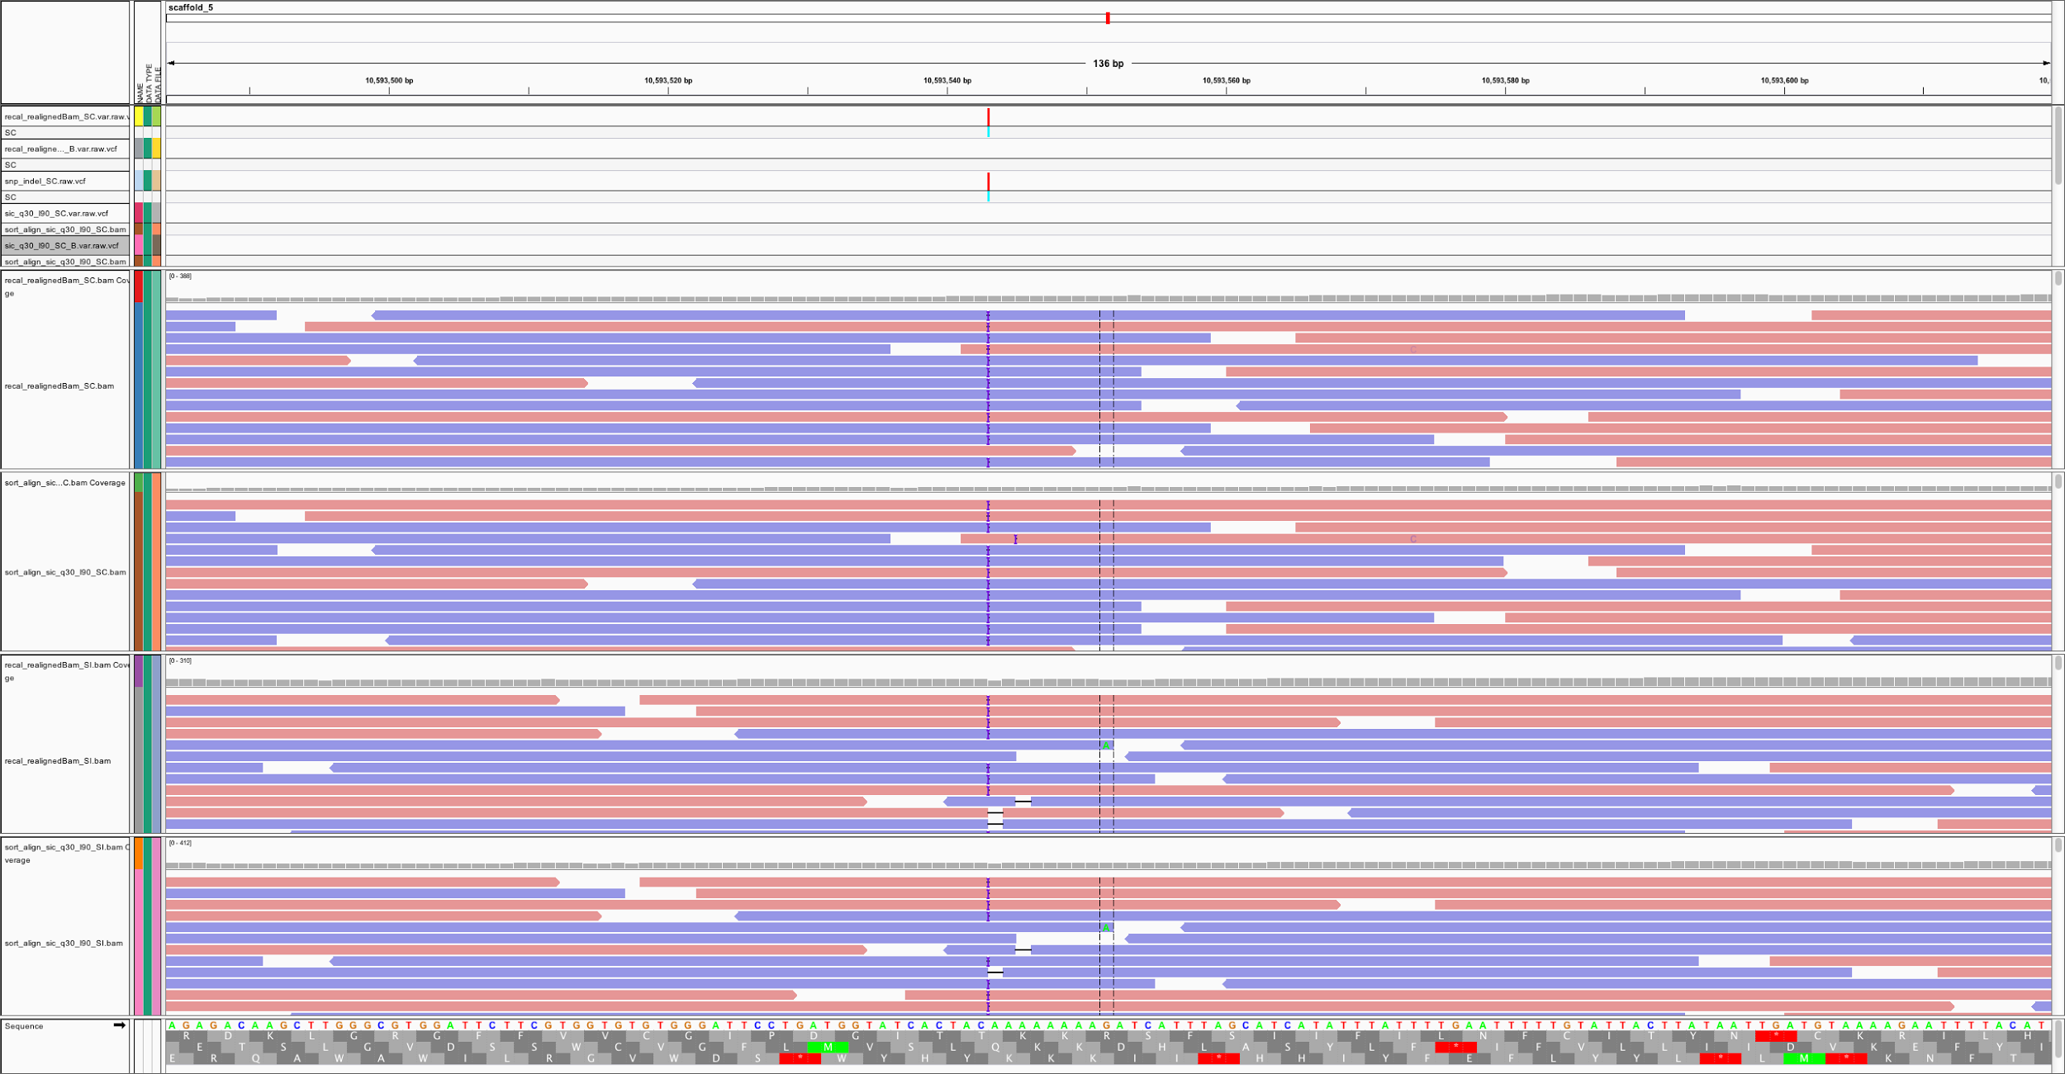
Visualizing SNPs in IGV

Slide 11
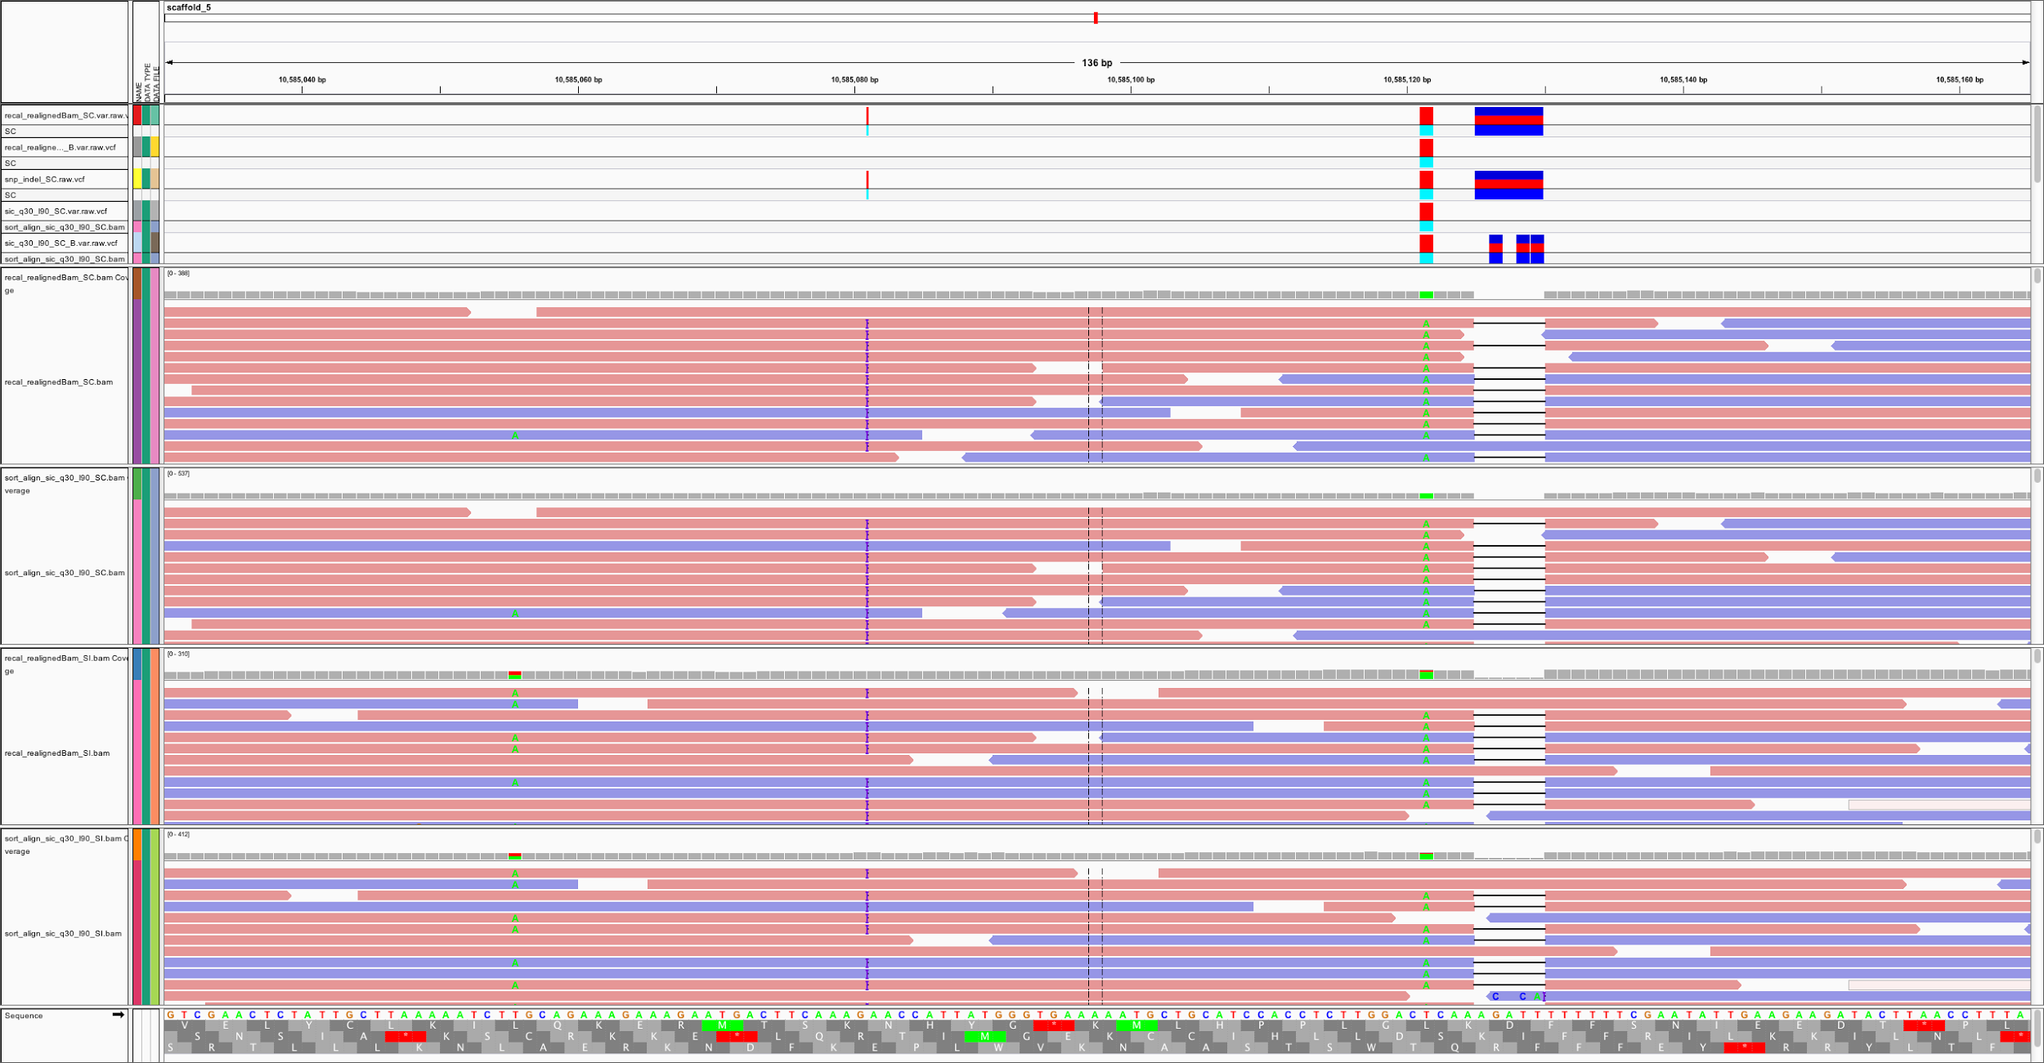
Issues in SNP calling

Slide 12
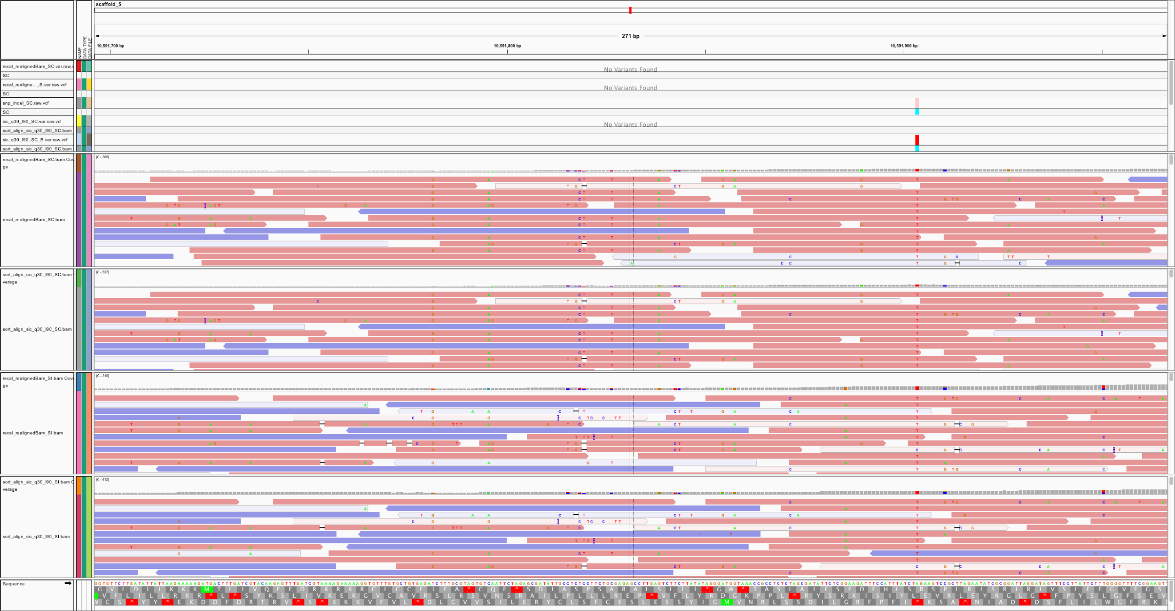
Issues in SNP calling

Slide 13
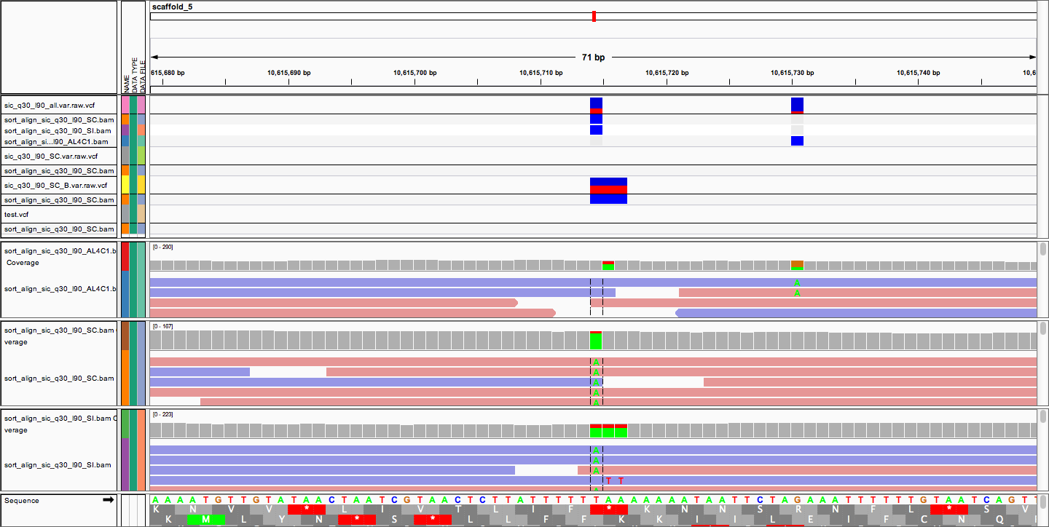
Issues in SNP calling

Slide 14
snpEff
Annotate Variants
In a coding region? Which gene?
Non-synonymous?
Upstream/Downstream
snpSift can be used to filter based on these annotations

Slide 15
Vcf-tools
Used to compare files
Can also get statistics (e.g., count SNPs)

Slide 16
Session 3 Tasks
Filter variants with GATK if you did not finish yesterday
View your variants and alignments alongside the genome with IGV
Annotate your variants with snpEff
Requires database build - see later slide
View the html output. Is this useful to you?
Extract useful variants with snpSift
What do you think would be useful?

Slide 17
Session 3 Tasks
Compare variants between your samples with vcftools
You will have to install this (sorry!) See later slide
How many variants are different? How could you display this data in a paper? Can you make a Venn diagram of your variants?

Slide 18
Making SnpEff Database
Edit snpEff.config
At the top change data.dir to ~/Data/Reference
Add a line “TriTrypDB-25_LmexicanaMHOMGT2001U1103.genome : TriTrypDB-25_LmexicanaMHOMGT2001U1103”
Move snpEff.config to ~/Data/Reference
Make a new dir ~/Data/Reference/TriTrypDB-25_LmexicanaMHOMGT2001U1103
Move the reference gff file into this dir and rename it genes.gff
java -jar /usr/local/bin/snpEff.jar build -gff3 -v TriTrypDB-25_LmexicanaMHOMGT2001U1103

Slide 19
Installing vcftools
sudo apt-get install autoconf
git clone https://github.com/vcftools/vcftools.git
export PERL5LIB=<vcfdir>/src/perl/
cd into vcftools dir
./autogen.sh
./configure
make
sudo make install
vcftools --vcf <file1> --diff <file2> --out compare --diff-site

Slide 20
Summary
You have filtered variant files for Wild Type and AmpB resistant mutant type. You are able to compare these two files and identify the SNPs that are unique to each individual file.
Generate a Venn Diagram showing the SNP overlap between the two samples.

Slide 21
The Next Step
There is still a long list of SNPs that are specific to the AmpBR sample…how can these be narrowed down?
Proteomics Session
Metabolomics Session
We will continue this in Genomics Session 4

